Slide 1
Family Resource Guide
Response to Covid-19
Treadwell Counseling Services
Donna Gilliam, Professional School Counselor

Slide 2
Resource Guide
Parents, this resource guide will give you quick access to resources as you and your scholar deal with this pandemic, Inside of this guide are resources for the following:
Social Emotional Support
Virtual Tutoring and Therapy
Calming and Relaxation Apps (Phone)
Registration Information for the 2020-21 school year
Meal Distributions
Variety of Essential Services
Covid-19 Fact Sheets
Instructional Resources
Family Resources
ELL Resources

Slide 3
Social Emotional Support

Slide 4
Virtual Tutoring and Therapy

Slide 5
Calming and Relaxation Apps
Need to be calmed and relaxed. Try downloaded the following apps to your phone for relaxation:
Breathe, Think, Do Sesame
Kids Yoga Deck
Smiling Mind
Super Stretch Yoga
Breathing Bubbles
Dreamy Kid
Calm
Calm Corner
Take a Chill

Slide 6
Registration for the 2020- 21 School Year

Slide 7
Meal Distribution

Slide 8
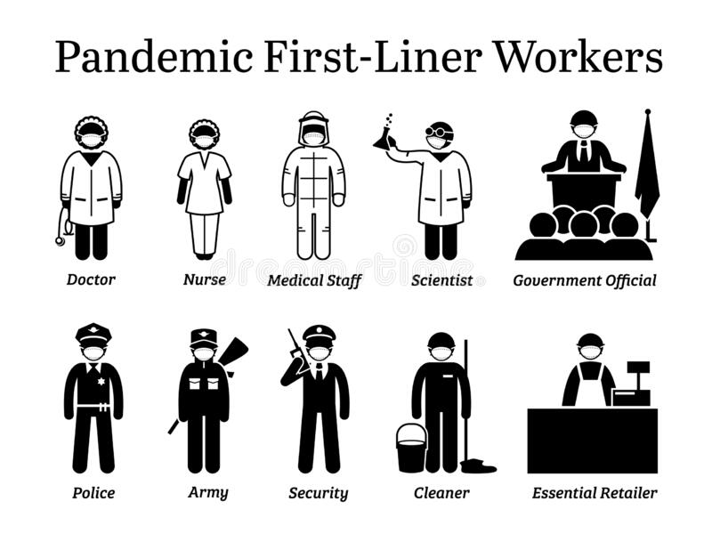
Essential Services

Slide 9
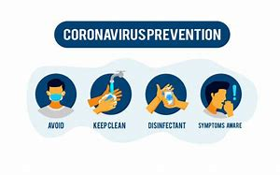
COVID-19 Fact Sheets
Use the following links to read information on the disease and precautionary measures your family can take.
https://www.who.int/docs/default-source/coronaviruse/healthy-parenting/english-tip
https://www.who.int/docs/default-source/coronaviruse/healthy-parenting/english-tip-6-covid-19parenting.pdf?sfvrsn=232558c1_8
https://www.cdc.gov/coronavirus/2019-ncov/index.html

Slide 10
Instructional Resources
SCS Instructional Guides
http://www.scsk12.org/instructionalresources/index#/
Treadwell Middle School Virtual Lessons presented and written by the school’s faculty:
https://www.youtube.com/channel/UCZo4Hu0tkSNxWwa86rxYT_Q/playlists

Slide 11
Discovery education free for Scs Scholars
To access lesson and videos for free, click on the following link for Discovery Education:
http://www.scsk12.org/instructionalresources/discovery

Slide 12
School on TV
Here’s a quick rundown on all the different ways you can watch “School on TV."
On TV
Channel 5.2 on antenna TV (Bounce)
Channel 906 on Comcast
Channel 6 on Dish Network
On WMCActionNews5.com
Click on the “School on TV” tab at the top of the page. Each grade level has its own page. Just click “watch live” beside each lesson.
On the WMC Action News 5 news app (Click here for Apple | Click here for Android)
Click the Education button under News in the menu.
On our streaming apps
Download the WMC app on Roku, Amazon Fire or Apple TV.
Each app has three separate swimlanes, one for each grade grouping -- K-5, middle school and high school.

Slide 13
Family Resources
To access the SCS list of family resources. Click on the following link:
http://www.scsk12.org/coronavirusfacts/familyresources

Slide 14
ELL Resources
Please click on the following link for ELL resources:
http://www.scsk12.org/instructionalresources/ell.php?PID=1657

Slide 15
Email Questions and Concerns
Parents if you have any questions or concerns. You can email TMS Counseling Services at
All responses will be returned within 48 hours by one of the school counselors.

